Slide 1
جمهوری اسلامی افغانستان
وزارت مالیه
د افغانستان اسلامي جمهوریت
د مالیې وزارت
Islamic Republic of Afghanistan
Ministry of Finance
Macro-Fiscal Policy Department - MFPD
Cash Management Report
April 7, 2021

Slide 2
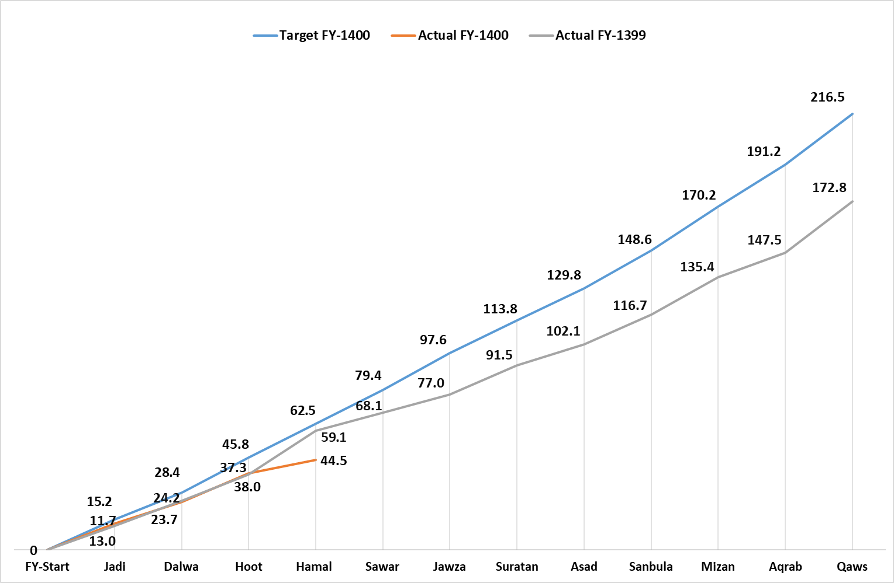
Overall Revenue Performance

Slide 3
FY-1400 Actual Revenue Targets VS Actual Performance
Agency | Annual Targets | YTD-1400 | YTD – 1400 | Difference in Value | Difference in %
Customs Department (ACD) | 101,369 | 29,794 | 20,891 | -8,903 | -30%
Revenue Department (ARD) | 115,131 | 27,302 | 23,614 | -3,688 | -14%
• Mustofiats | 19,282 | 5,228 | 4,300 | -928 | -18%
• Ministries | 42,687 | 8,318 | 5,792 | -2,525 | -30%
• LTO | 30,141 | 7,800 | 7,683 | -116 | -1%
• MTO | 16,467 | 4,261 | 3,766 | -495 | -12%
• STO | 3,987 | 1,032 | 1,500 | 469 | 45%
• Audit department | 2,567 | 664 | 572 | -92 | -14%
Total | 216,500 | 57,097 | 44,505 | -12,591 | -22%

Slide 4
Individual Customs
Agency | Annual Targets | YTD - 1400 Target | YTD – Actual | Difference | Diff in %
Herat Custom | 22,845 | 6,715 | 4,482 | -2,233 | -33%
Nangarhar Custom | 19,870 | 5,840 | 3,615 | -2,225 | -38%
Kandahar Custom | 13,666 | 4,017 | 2,980 | -1,037 | -26%
Balkh Custom | 16,397 | 4,819 | 3,378 | -1,441 | -30%
Nimroz Custom | 9,848 | 2,895 | 2,308 | -586 | -20%
Faryab Custom | 5,552 | 1,632 | 1,036 | -596 | -37%
Farah Custom | 4,590 | 1,349 | 654 | -695 | -51%
Custom Airport | 2,398 | 705 | 600 | -105 | -15%
Paktya Custom | 1,500 | 441 | 383 | -58 | -13%
Khost Custom | 1,363 | 401 | 406 | 6 | 1%
Paktika Custom | 1,157 | 340 | 78 | -262 | -77%
Kunduz Custom | 1,098 | 323 | 289 | -33 | -10%
Kabul Customs | 999 | 294 | 648 | 354 | 121%
Custom Post Porcel | 47 | 14 | 11 | -3 | -22%
Takhar Custom | 25 | 7 | 8 | 1 | 11%
Badakhshan Custom | 6 | 2 | 2 | 1 | 47%
Kunarha Custom | 8 | 2 | 11 | 9 | 377%
Total | 101,369 | 29,794 | 20,891 | -8,903 | -30%

Slide 5
Top Mustofiats
Agency | Annual Target | YTD - 1400 Target | YTD – Actual | Difference | Diff in %
Herat Mustofiats | 3,839 | 1,041 | 784 | -257 | -25%
Nangarhar Mustofiats | 2,211 | 600 | 487 | -112 | -19%
Balkh Mustofiats | 2,101 | 570 | 644 | 74 | 13%
Kandahar Mustofiats | 1,672 | 453 | 306 | -148 | -33%
Paktya Mustofiats | 1,072 | 291 | 245 | -46 | -16%
Helmand Mustofiats | 687 | 186 | 159 | -28 | -15%
Khost Mustofiats | 620 | 168 | 137 | -31 | -18%
Parwan Mustofiats | 591 | 160 | 129 | -31 | -19%
Ghazni Mustofiats | 570 | 155 | 141 | -13 | -9%
Kunduz Mustofiats | 522 | 141 | 158 | 16 | 11%
Nimroz Mustofiats | 466 | 126 | 74 | -53 | -42%
Faryab Mustofiats | 400 | 108 | 103 | -6 | -5%
Jawzjan Mustofiats | 361 | 98 | 67 | -31 | -32%
Baghlan Mustofiats | 352 | 95 | 102 | 7 | 7%
Other Mustofiats | 3,817 | 1,035 | 765 | -270 | -26%
Total | 19,282 | 5,228 | 4,300 | -928 | -18%

Slide 6
Top Ministries
Agency | Annual Targets | YTD - 1400 Target | YTD – Actual | Difference | Diff in %
Ministry of Communication Information Technology | 8,512 | 1,658.6 | 1,551 | -108 | -7%
Civil Aviation Authority | 7,455 | 1,452.7 | 1,071 | -381 | -26%
Ministry of Foreign Affairs | 6,030 | 1,175.0 | 419 | -756 | -64%
Ministry of Interior Affairs | 4,860 | 946.9 | 1,107 | 160 | 17%
Ministry of Mines | 3,068 | 597.8 | 37 | -561 | -94%
Ministry of Finanace | 2,986 | 581.8 | 62 | -520 | -89%
Afghanistan Railway Authority | 2,690 | 524.2 | 665 | 141 | 27%
National Statistics and Information Authority (NSIA) | 1,646 | 320.6 | 64 | -257 | -80%
Ministry of Labor and Social Affairs | 1,096 | 213.5 | 44 | -170 | -80%
Afghanistan National Standard Authority | 865 | 168.6 | 3 | -166 | -98%
Ministry. of Trasport | 656 | 127.8 | 14 | -114 | -89%
Ministry of Urban Development and Land (MoUDL) | 493 | 96.1 | 122 | 26 | 27%
Supreme Court | 487 | 94.9 | 194 | 99 | 104%
National Security Council | 261 | 50.8 | 12 | -39 | -77%
Other Ministries | 1,583 | 308.4 | 429 | 120 | 39%
Total | 42,687 | 8,318 | 5,792 | -2,525 | -30%

Slide 7
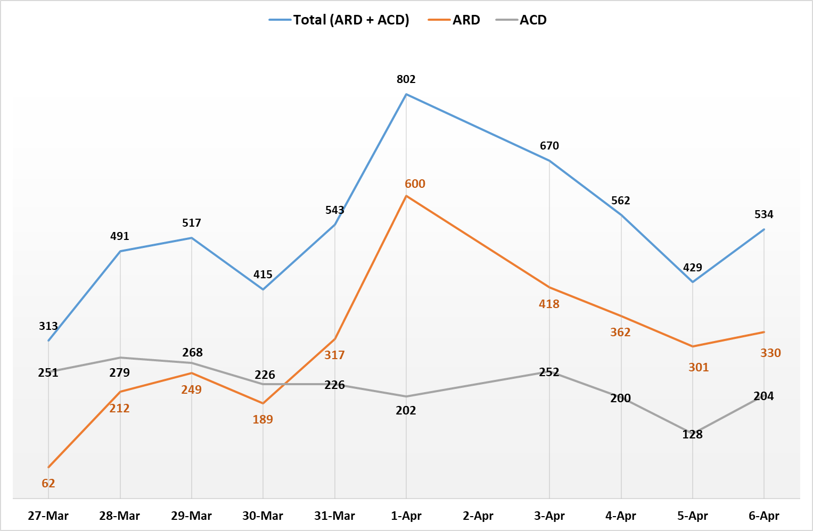
Daily Performance

Slide 8
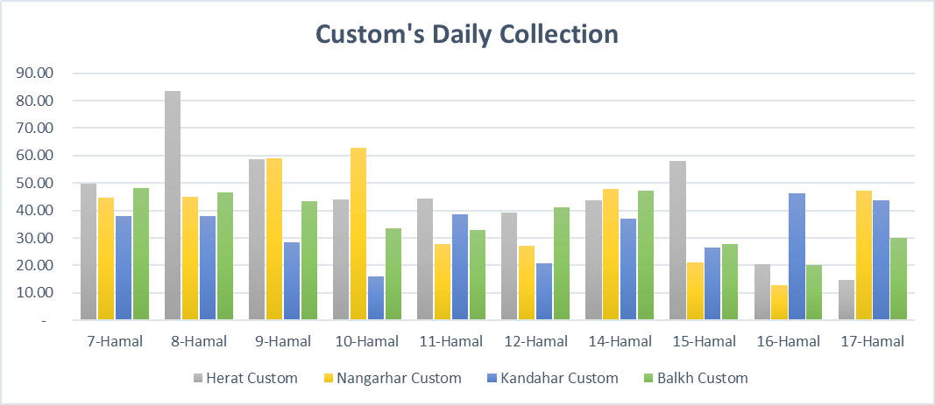
Top Custom's Daily Collection

